Slide 1



Bookiboo - Online Bookstore Project Semester 2
Installation Guide
Faculty: | Mrs. Le Mong Thuy
Batch No: | T12406E1
Group No.: | 01
Students: | Full Name | Roll No.
1. | Vũ Thị Hoài Thu | T1S2404004
2. | Thân Thế Lộc | T1S2404009
3. | Nguyễn Khải Nguyên | T1S2405014
4. | Hồ Anh Toàn | …
MAY, 2025

Slide 2
System Requirements
HARDWARE REQUIREMENTS
Minimum
ADMIN/ USERS | Intel core I7. 32GB RAM.
Recommended
ADMIN/ USERS | Intel core I5. 8GB RAM or higher.
SOFTWARE REQUIREMENTS
ADMIN/USERS | Microsoft® Windows 10/11. XAMPP. PHP MySQL. GitHub.

Slide 3
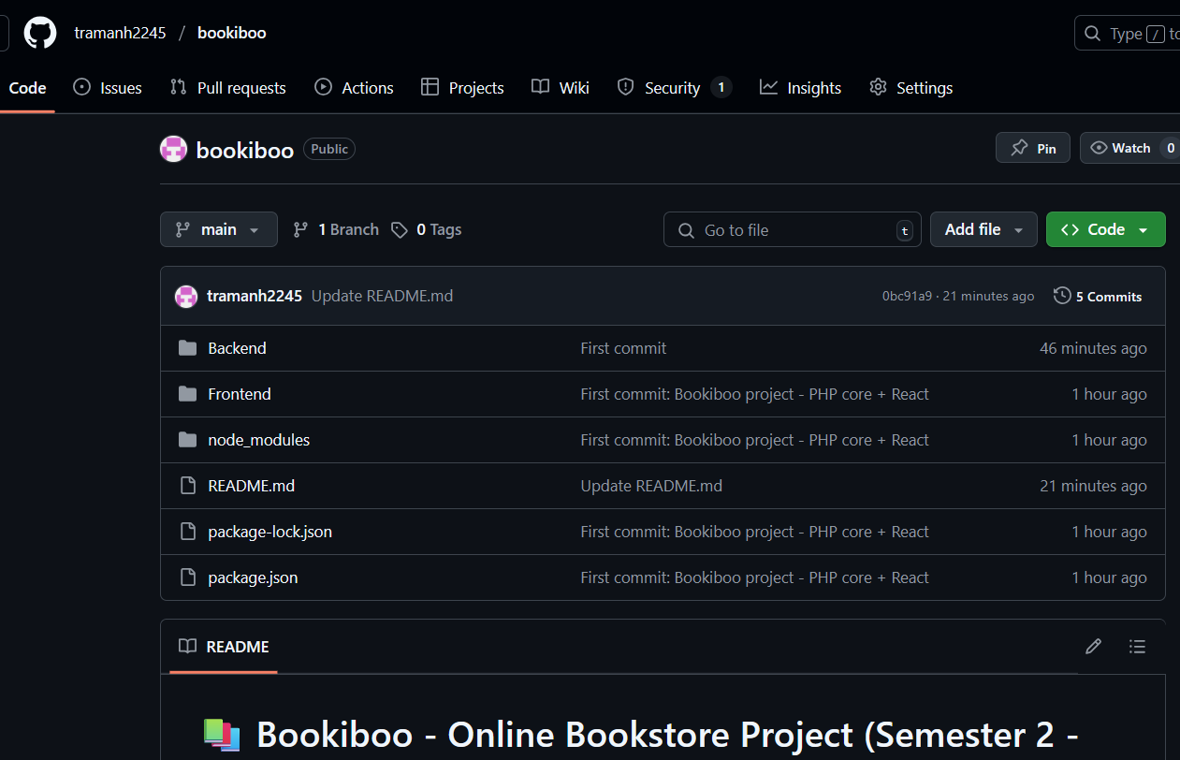
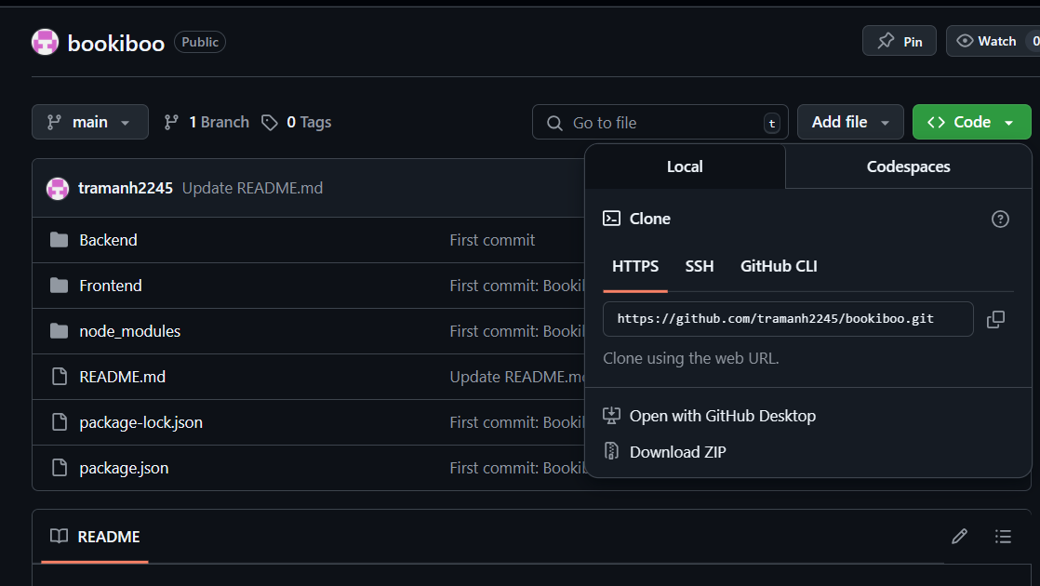
Clone Project to computer
Open : https://github.com/tramanh2245/bookiboo
- Click <> code -> download ZIP

Slide 4
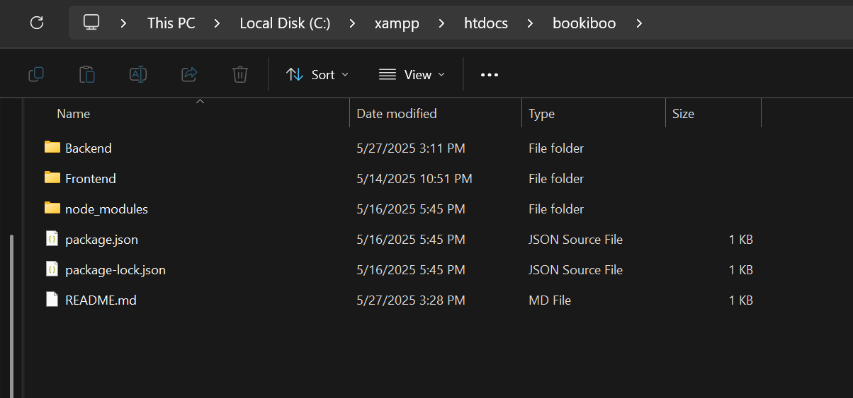
2) Create a project folder in C:\xampp\htdocs\
Open This PC on your computer and navigate to drive C.
Go to the directory: C:\xampp\htdocs\
Create a new folder with your desired project name, for example: bookiboo (Right-click → New → Folder → enter the folder name)
3) Open the Bookiboo project you downloaded
then copy the Backend and Frontend folders into the project folder you just created.

Slide 5
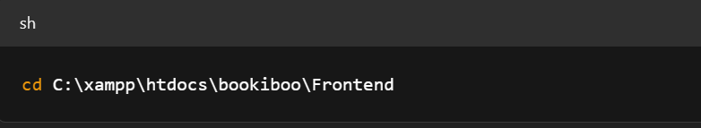
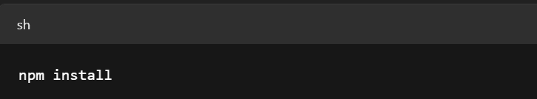
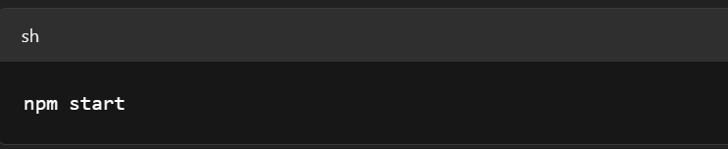
4) You need to install the dependencies and start the ReactJS project
Open a terminal or Command Prompt.
Install all required dependencies:
Start the ReactJS application

Slide 6
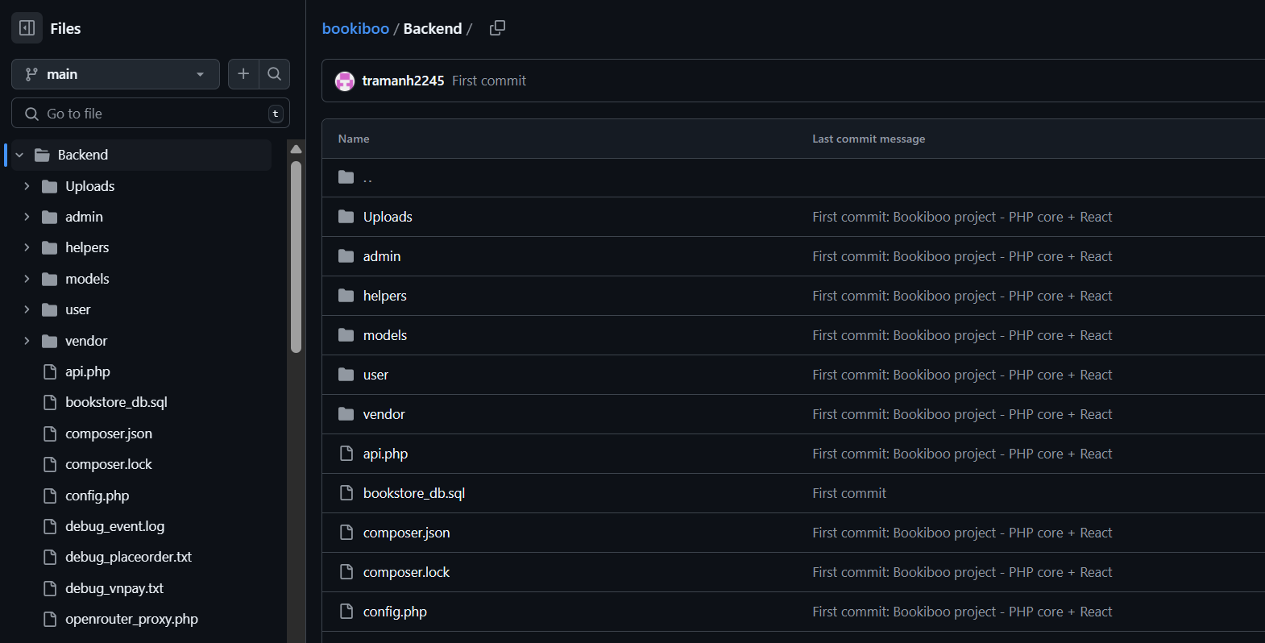
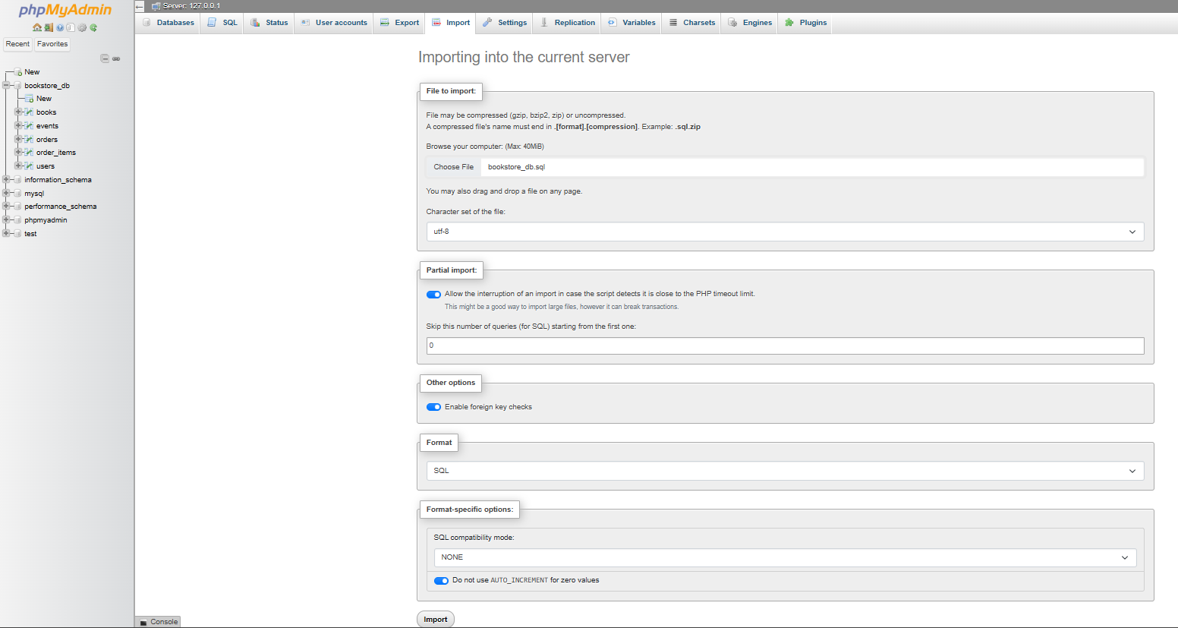
5) Import Database:
Open PHPMyAdmin
Click Import
Choose bookiboo\Backend bookstore_db.sql

Slide 7
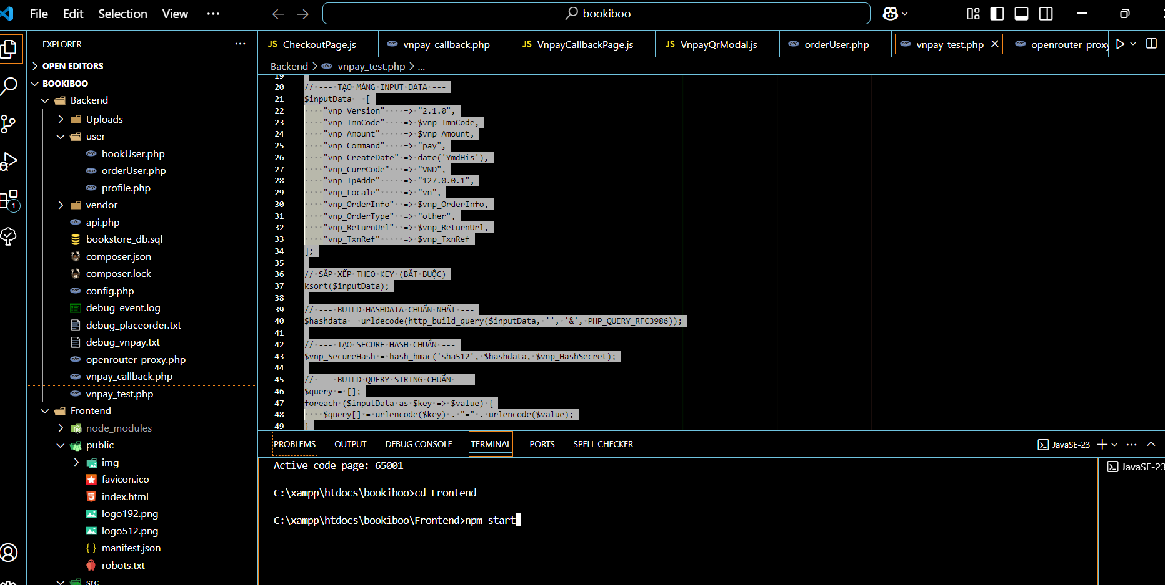
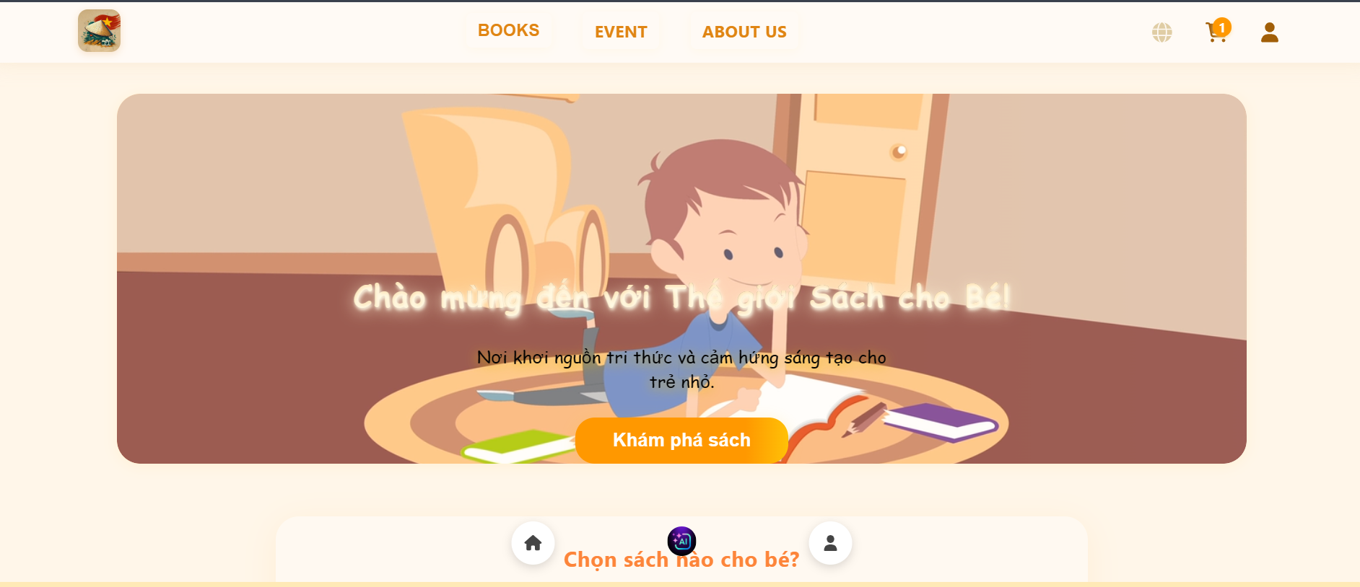
6) After setting up the database, go to visual code run project
This is hompage

Slide 8
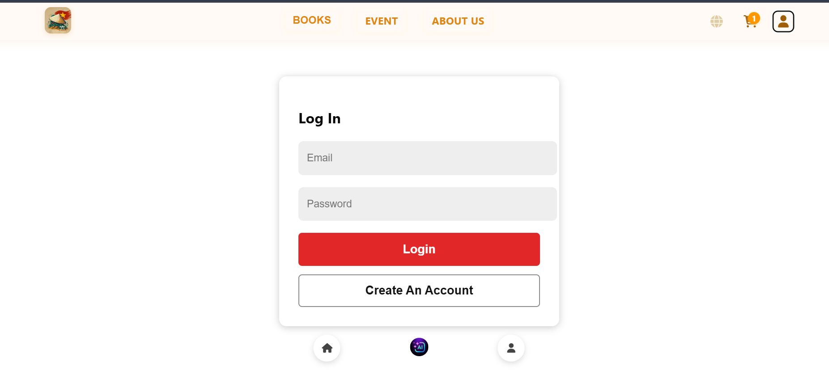
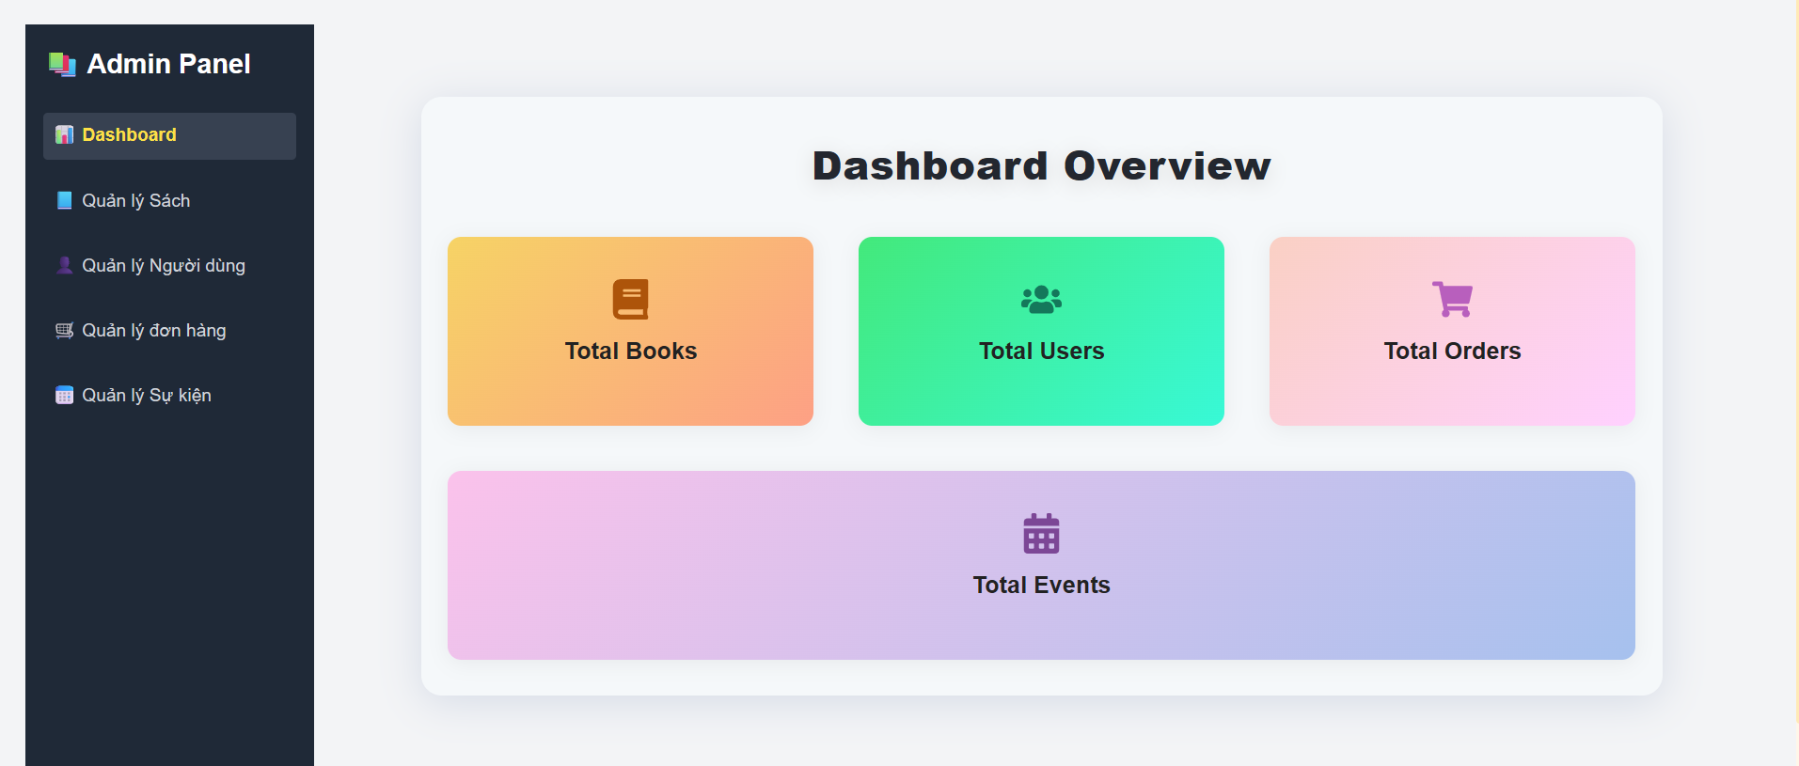
7) If Login Admin: (Can create staff) Username: h@gmail.com Password: 12345678
Go to admin screen login page trang
Administration screen
-

Slide 9
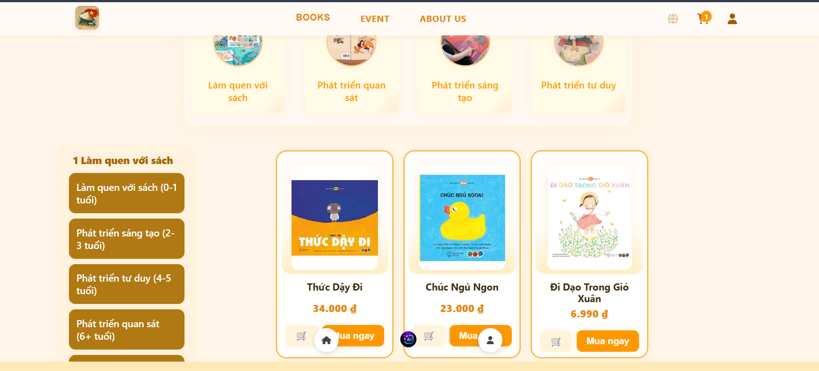
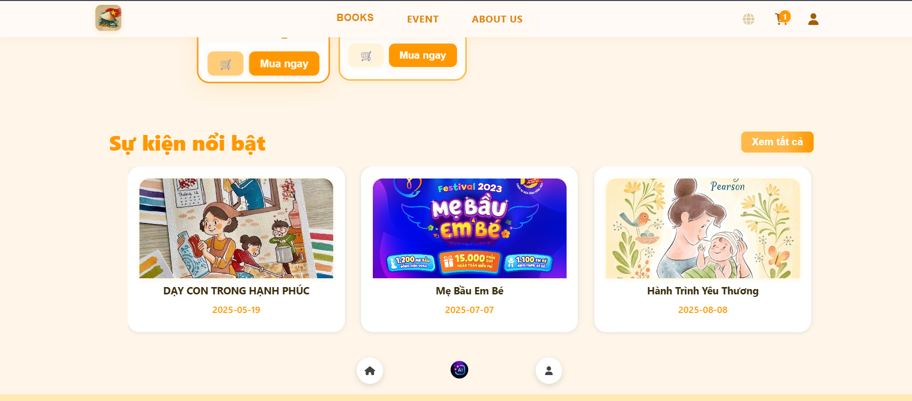
If user login : (Cannot create employee) username@gmail.com Username: password
After successful login, the username screen appears

